Slide 1
LESSON NINE
TOPICS: HOW TO ENABLE THE TARGET TO DETECT HITS AND THEN FLASH.

Slide 2
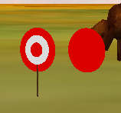
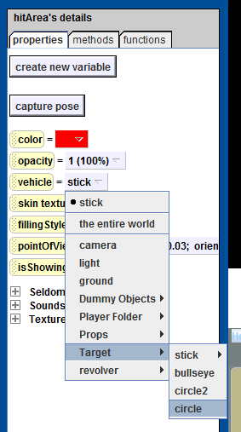
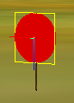
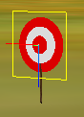
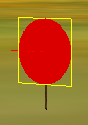
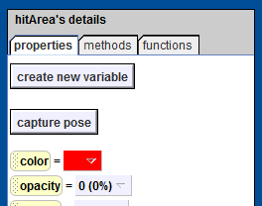
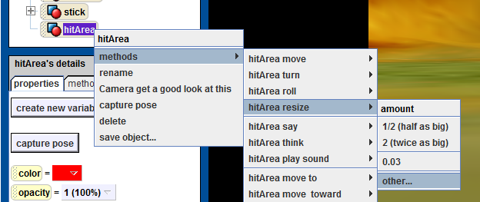
Step 1: Create the Target Hit Area
Find and copy the “circle” object that is part of the target, and name the new circle “hitArea”.
Set the hitArea’s point-of-view to that of the circle.
Move the hitArea up 0.03 meters. The hitArea should now be in front of the Target.
Set the Vehicle of the hitArea to the circle.
Resize the hitArea by 1.2.
Set the hitArea opacity to 0

Slide 3
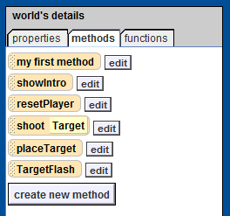
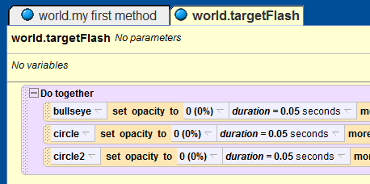
Step 2: Create the targetFlash Method
Add a new method to the world object called “targetFlash”.
Add a “do-together” method to the targetFlash method.
Add the following three lines to the do-together method:
.
.
.
Add a “do-together” block at the end of the targetFlash method.

Slide 4
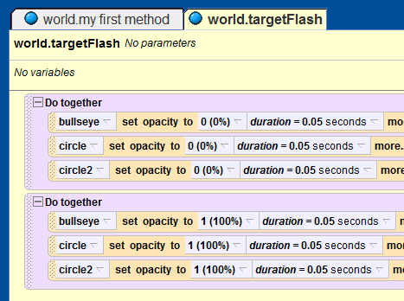
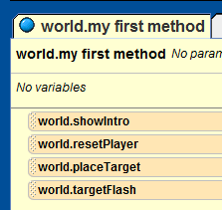
Step 3: Add the Code to Make the Target Visible Again
Add the following three lines to the last do-together method:
.
.
.
Add the targetFlash method to the end of the “world.my first method” method.
Notes:
Students should play the world and see the target flash.

Slide 5
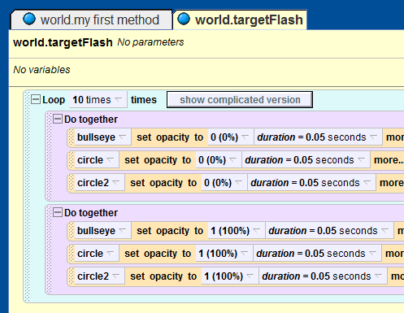
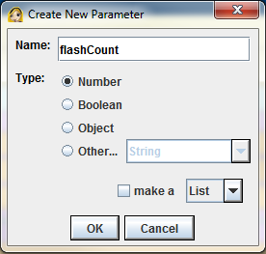
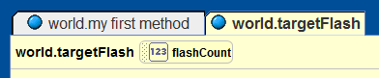
Step 4: Making the Target Flash a Variable Number of Times
Add a loop block to the targetFlash method, and drag both of the do-together methods inside of the loop block.
When prompted for a number, enter the number 10.
Add a parameter to the targetFlash method.
Name the new parapmeter “flashCount”, and set its type to “number”.
Notes:
Students should play the world and see the target flash.

Slide 6
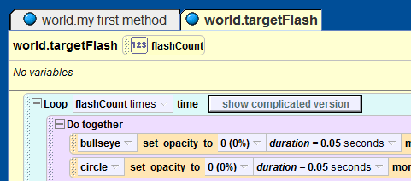
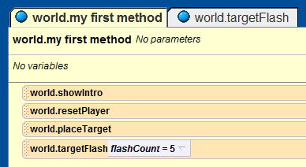
Step 5: Update the “world.my first method” Method
Change the “10” associated with the number of cycles through the loop to the flashCount parameter.
In the “world.my first method,” set the value for the targetFlash method’s parameter to 5.

Slide 7
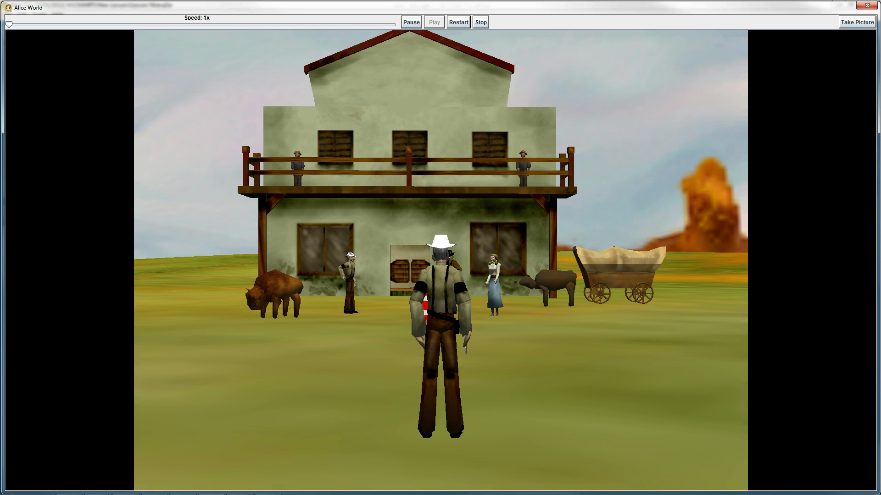
Final Scene

